Slide 1

Docker 102
Johannes Sim
Version: November 2018 1.0

Slide 2
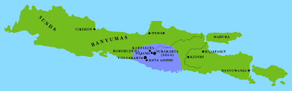




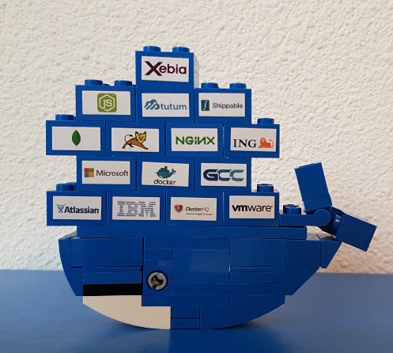
WHO is Johannes Sim?
1963
Since 1989 in IT, since 2000 for
CD journey since 2010
Agile + CD + DevOps with Docker and Azure
App 01.01.00.001
johannes.sim@centric.eu
Notes:
Mijn naam is Johannes Sim.
Ik ben een klassiek geschoolde IT-er en werk sinds 1989 in de IT.
En werk sinds 2000 met veel plezier als IT-consultant bij Centric.
Het leuke van de job is de verscheidenheid.
De rode draad bij mijn opdrachten is het leveren van software.
Vanaf 2010 ben ik in IT op reis gegaan en in aanraking gekomen met Agile, CD, DevOps, Container en Azure.
Ik ben lid van CC Azure binnen Centric en breng mijn Docker kennis in!
Voorzitter van werkgroep containerization binnen Centric
Opdrachten uitgevoerd bij KPN, ING, RWS

Slide 3
Docker 101
Goal:
Practical 101 Docker
Tell / Demo / DIY
Key take away:
What is Docker?
What can it do for you?
Audience: Centric DEV colleagues

Slide 4
CoNTENT Docker 102
Recap Docker 101
Container landscape
Workshop

Slide 5
WHY Containers (Docker)?
Software Delivery
No more: “works on my laptop!”
Time to Market
DevOps
Try something new / innovate
CI/CD (Continuous Integration / Continuous Delivery)
Time from commit to in production (cycle time)
Testing
…….
Notes:
DevOps
Time to Market
Time from commit to in production
Continuous Delivery
Build – Ship – Run
Works on my laptop
UseCase
Linux tool
Package manager

Slide 6
Notes:
Build-ship-run
Basic knowledge is essential

Slide 7
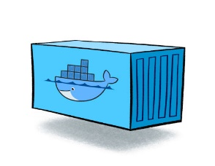
DOCKER Definition
Is the world's leading software container platform
available for developers, ops and businesses
to build, ship and run
any app
on any infrastructure.
Notes:
Waarom deze deze definitie:
World leading op dit moment
Container = Docker
Actors: dev / ops /business
ANY app (microservice / monolit / enz)
Infra (laptop / server on premise / cloud

Slide 8
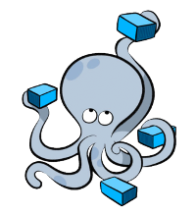
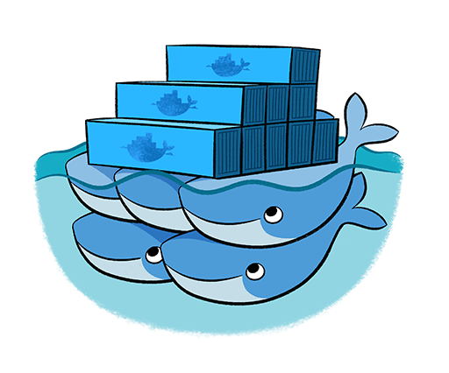
CONTAINER learning
Docker
Docker-compose
Kubernetes (K8s)
Docker-swarm
Kubernetes (K8s)

Slide 9

Container MIndset
Standard
Build– Ship – RUN AAA
Ephemeral
Immutable (consistent)
Isolation
Container in “production”
Everything what is needed and nothing more
(middleware, app code, libs, framework, binaries)
1 process – 1 task
“works on my machine!”

Slide 10
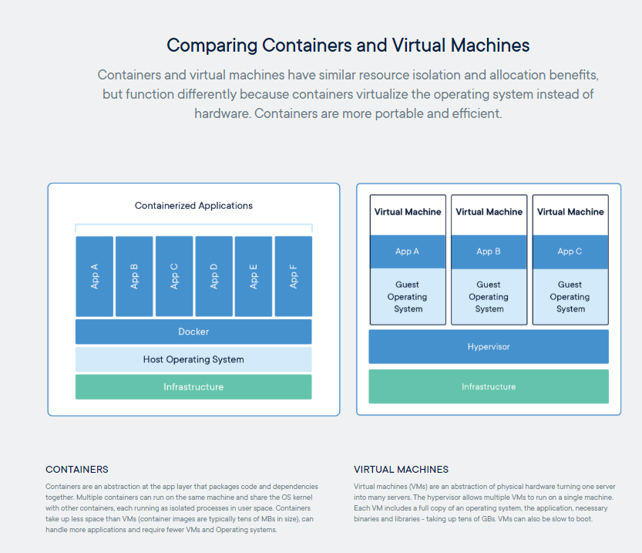
TOPIC: VIRTUAL MACHINE versus Container
Notes:
Docker containers are not VM’s
Analogy
Apartment building = VM
Apartment = Docker Container
Share of kernel
Real world
DockerHost are VM’s
Docker can also run directly on server with OS

Slide 11
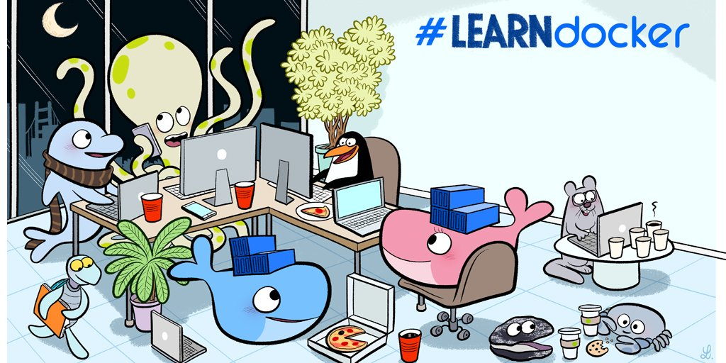
Workshop

Slide 12
Workshop
Tell + demo
Do It Yourself (DIY)
Summarize

Slide 13
Workshop Map 101
Install workshop environment & check
Container life cycle
Container
Registry
Image
Dockerfile
Example container (portainer)
Build-Ship-Run workflow example

Slide 14
WoRKmap 102
Recap 101
Container image
Dockerfile
Build-Ship-Run AAA example
Volume
Network
Docker-compose
Multistage build
An Angular build environment in Docker
Examples

Slide 15
WORKshop day 3
Recap + remaining day 1 and day 2
Kubernetes introduction
Windows containers
CI/CD example
Assignment Docker & microservices

Slide 16
Learn
Container OS
RunC
Container Engine
Containerd
Container
Docker-compose
CNCF
DockerHost
Volume
Microservices
Play with Docker
Play with Kubernetes
Container Image
Docker Enterprise / Docker EE
DockerHub
Containers in Cloud
DockerStore
Docker swarm
Docker Engine
Docker Inc
Windows containers
Kubernetes (K8s)
Docker For Desktop
Container network
DockerHub
Container Registry
Linux containers
K8S Cluster
Docker CE
Container Orchestration
Notes:
Producten -groen
Process
concepten - oranje
Standaarden – blauw
People: niet in plaat

Slide 17
workshop environment

Slide 18
ABOUT THIS WORKSHOP
Open source software (OSS)
Docker CE
Visual Studio Code
Work with sources in Visual Studio Code
Images from DockerHub
(Base) images
Working with CLI
PowerShell
In Visual Studio Code

Slide 19
OUR Workshop environment

Slide 20
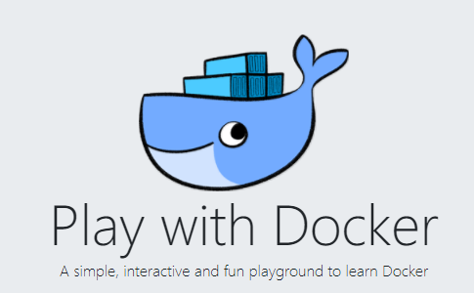
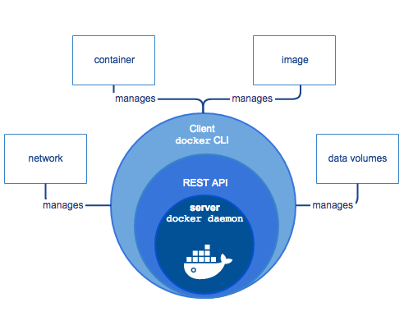
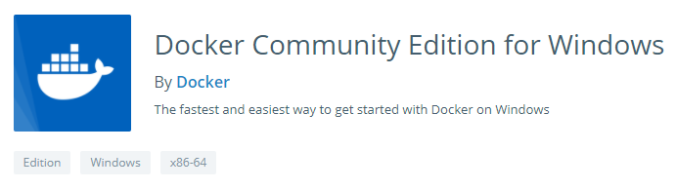
CONFIGURATION for DOCKER PLAY
Container

Slide 21
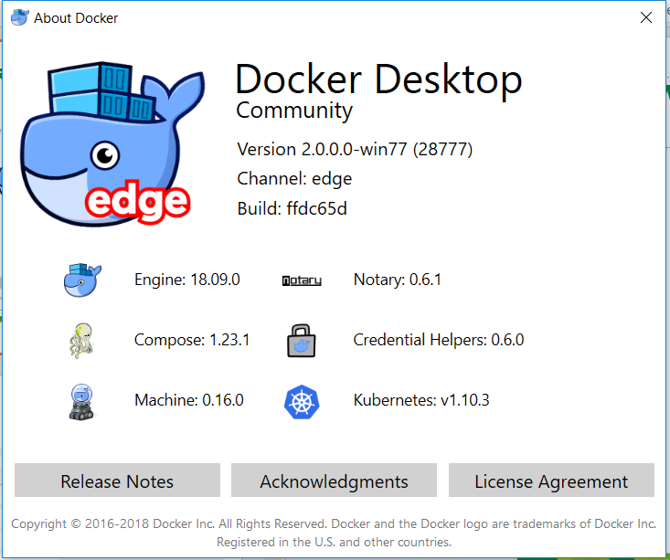
OUR work environment

Slide 22
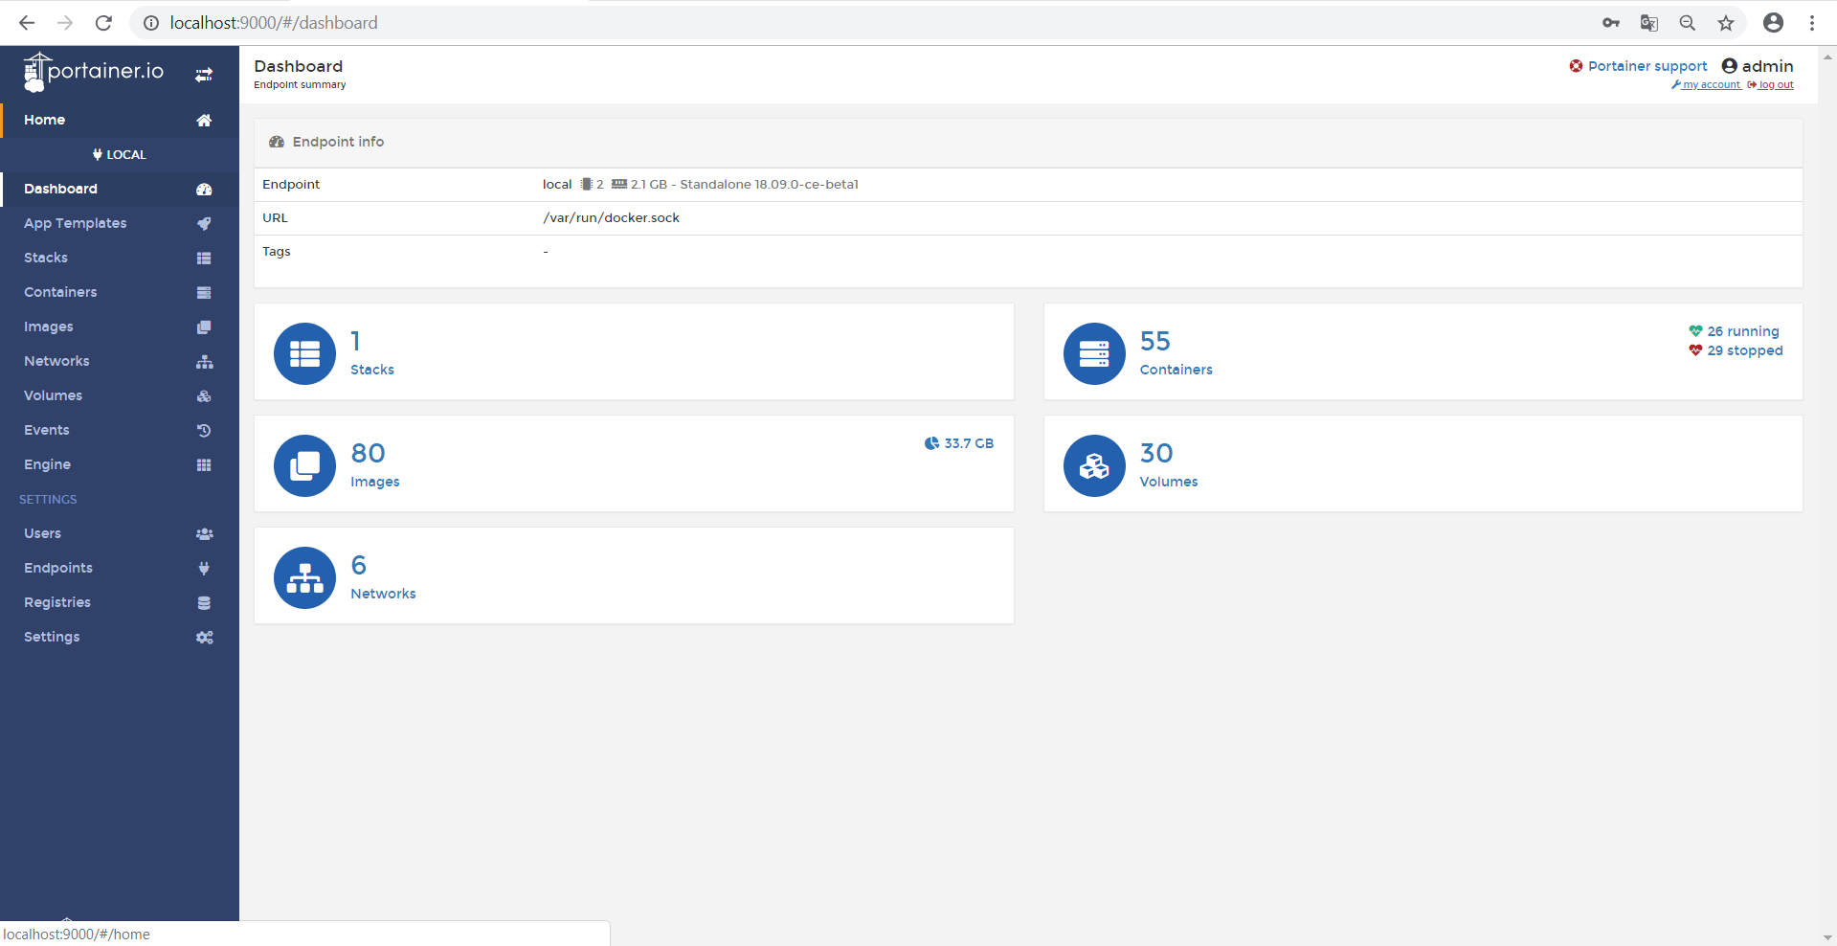
Use Portainer
docker run -d -p 9000:9000 --name portainer --restart always -v /var/run/docker.sock:/var/run/docker.sock -v portainer_data:/data portainer/portainer
Notes:
docker run -d -p 9000:9000 --name portainer --restart always -v /var/run/docker.sock:/var/run/docker.sock -v portainer_data:/data portainer/portainer

Slide 23
Container life cycle

Slide 24

Docker in a GLANCE

Slide 25
Docker Command LINE INTERFACE
Build
Ship
Run
Docker image ls
Docker container run
Docker pull
Docker container ls
Docker image rm
Docker push
Docker container rm
Docker image build
Docker container exec
Docker container start
Docker container stop
Docker system info
Docker system prune
Docker version
Notes:
docker system info
docker info
docker info
Command Line Interface

Slide 26
Quiz Questions
Why use –a option?
docker container ls –a
What do you start?
docker container start <id>
What do you get with:
docker container run -it microsoft/powershell sh
Can you run Windows containers on Linux DockerHost?
Can you mention a use case for image-id and/or container-id?

Slide 27
(Container) IMAGE

Slide 28
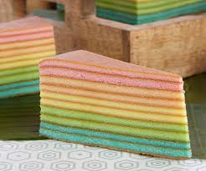
What is an Image?
Union FS
Layers
Layer is only stored once
Compare with a class
Build with a Dockerfile
Best practice: Keep images small
Note: image is also on DockerHost

Slide 29
Images
Base image
Scratch
Best practice Linux OS or Windows OS
Small Linux distro → alpine (3.8: 5MB)
Small Windows base image → nano server (1803: 145 MB)
Image for production
Images for building apps (intermediate images)
Multistage build

Slide 30

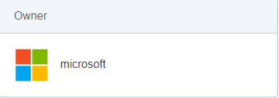
intermezzo
Linux and Windows containers
.net core on “Linux”
.net core on “Windows container”
https://hub.docker.com/r/microsoft/dotnet/
DockerHub
Official images
Private images
Multi OS

Slide 31
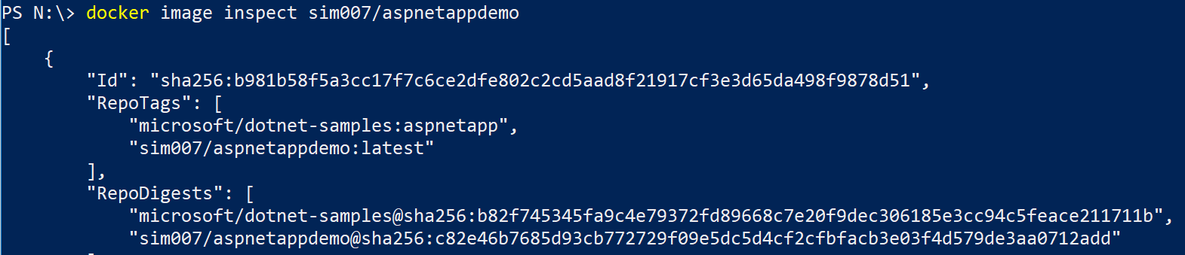
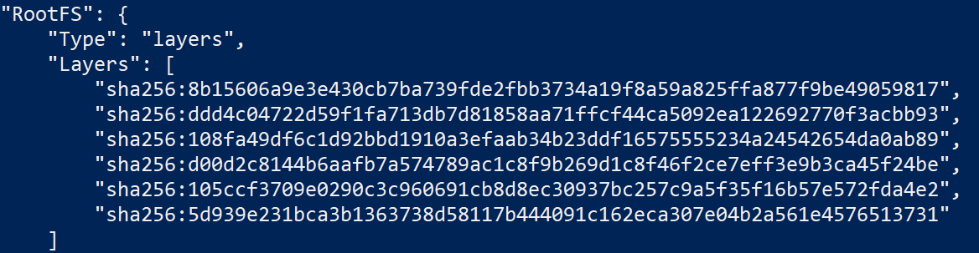
Docker image inspect
Notes:
Same image-id, different tags
layers

Slide 32
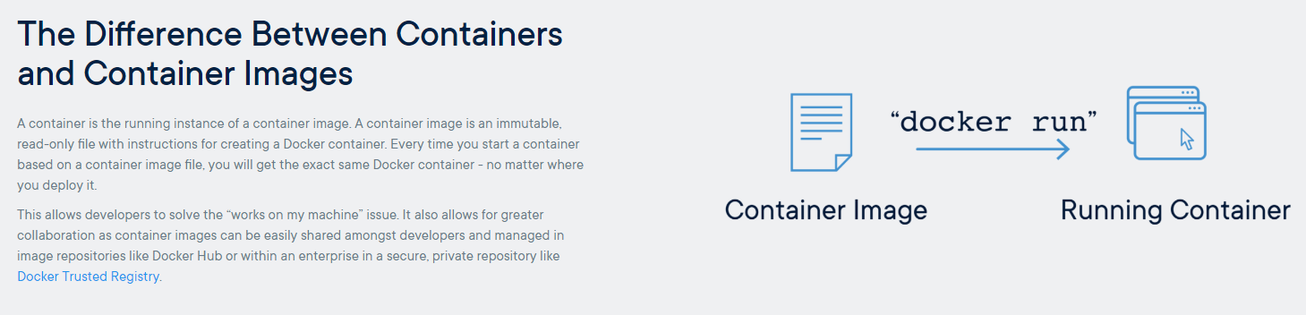
DIY

Slide 33
DOCKERFILE

Slide 34
DOCKERFILE
Recipe or blueprint
Each line will be layer
Each layer will be cached
Process: dockerize – containerize
Sources / Libs / executables on laptop
.dockerignore
In short:
Base image
Files
Commands
Start

Slide 35

Build: (DOCKERIZE)
Dockerfile
Base image
Notes:
Container:
Iets nodig dat communiceert met de kernel van het host OS.
Je zou kunnen starten met niets – scratch.
Maar dit is niet handig, omdat je dan alle benodigde libraries en binaries zelf moet installeren.
Handiger is dus hier met een OS te beginnen.
Een mogelijk is om het OS te gebruiken van HostOS.
In de begintijd werd dit ook gedaan.
Waarom zou je dit doen. In ons geval hebben we bijvoorbeeld het volgende niet nodig:
de GUI van Linux
ook alle plugins en drivers
Docker gebruikt Linux versie Alpine (4 MB) als start.
Wij hebben ook een webserver nodig.
Dit is kant en klaar beschikbaar in de Docker store.
Ze hebben deze zelfs verpakt als image met alpine erbij.
Je haalt 1 image op maar het zijn 2 layers.
Docker is ook slim met het opslaan.
Docker slaat alleen layers op die hij nog niet heeft.
Caching!

Slide 36
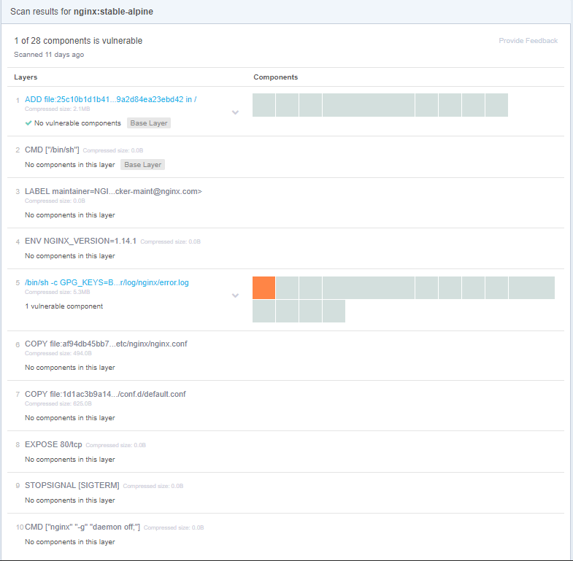
Example Layers: NGinX

Slide 37
DockerFILE: help
Visual Studio 2017 – Dockerfile en Docker-compose
GitHub
DockerHub
Google
Colleague

Slide 38

DIY
Image = stack of layers
Made by:
Dockerfile = recipe or blueprint
Docker commit – seldomly used – not in this Docker 101
Container
made from image must run on any environment
Instance
Writable layer

Slide 39
BUILD-SHIP-RUN AAA

Slide 40

OUR Container WORKFLOW
Build
Run
local
Ship
Run
“prod”
Notes:
Case: Static website
HTML pagina on webserver nginx
Code: HTML
Dockerfile
Build an image
Run container
Show result
Push to registry
Pull from registry
Run

Slide 41
DIY Build-SHIP-RUN AAA (AAA= Any app anywhere)
Workflow build-ship-run
Share your image
Intermezzo: copy files
Run on play-with Docker
On Laptop:
Run with Docker-compose
Run on K8S
On Azure:
ACI
WebApp

Slide 42
Volume

Slide 43
VOLUMe on different levels
Docker
Docker-compose
Kubernetes (K8s)
Docker-swarm
Kubernetes (K8s)

Slide 44
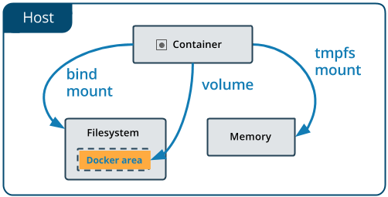
DOCKER VOLUME
Data in container is not persistent
Data persistent
Data in volume container – managed by Docker
Data mount on DockerHost → Docker Desktop
Data mount on NFS
Linux
Notes:
DEV flow – dev mode
Changes in code without building again

Slide 45

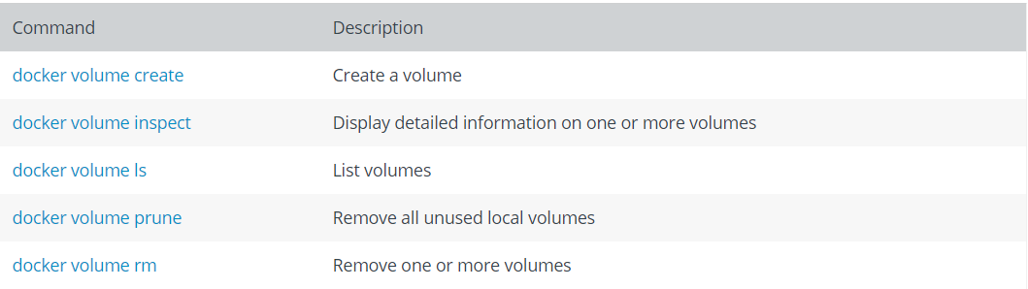
DOCKER volume - DIY
# | Data in | Command in docker container run | Remarks
1 | In Docker | -v dockervolume:/tmp | “volume container”
2 | On the DockerHost (mount) | -v /tmp:/tmp
3 | On Docker Desktop (mount) | -v ${pwd}/tmp:/tmp | Powershell!

Slide 46
NETWORK

Slide 47
NETWORK on different levels
Containers must find each other
Name or IP address
Docker
Docker-compose
Kubernetes (K8s)
Docker-swarm
Kubernetes (K8s)

Slide 48
Network
Software Network on different levels
Orchestration level
Docker-compose
Docker
Network
Bridge
Host
Overlay
Read more:
https://docs.docker.com/network/#network-driver-summary
Don’t want to know -> as a service
Example: Docker EE, K8s service in the cloud

Slide 49
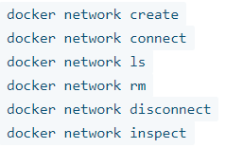
DOCKER Network - DIY
Engine – default network: docker0 – no DNS
Commands:
Docker Engine creates:
Bridge
Host
None

Slide 50
Docker-COMPOSE

Slide 51

A Container is not ALONE
web
API
db
bus

Slide 52
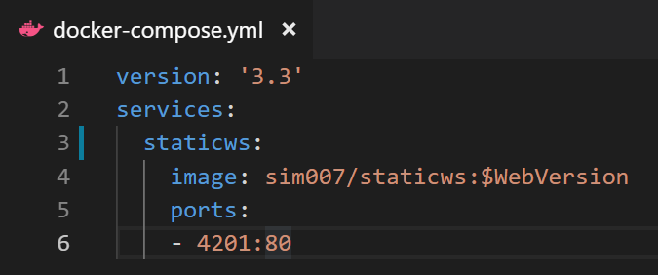
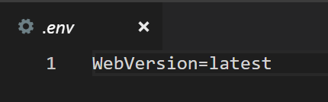
DOCKER-compose: 1 container
docker container run --name staticws -d -p 4200:80 sim007/staticws:latest
Docker-compose file:
.env file
docker-compose up en docker-compose down

Slide 53
DOCKER-COMPOSE in DTAP
For each environment a separate docker-compose
2 files
docker-compose - immutable
docker-compose-override - for environment variables
docker-compose default
docker-compose and docker-compose-override
docker-compose config
Verify what will be used
docker-compose makes its own network if not defined
Version of docker-compose

Slide 54
DIY dOCKER-COMPOSE
Example staticws
Example Wordpress
Example cats & dogs

Slide 55
MULTISTAGE BUILD

Slide 56
WHY: MultiSTAGE Build
Production container
Small
Only things that are needed for production
No build files
No compile files
No …
Intermediate container for build
Build
Output release
With 1 Docker build command
FROM

Slide 57

Example: Multi STAGE BUILD
Docker container run
Laptop
Source
Files
dll
.net 2.1 SDK
.net 2.1 runtime
Alpine
Alpine
Build: compile to app
Build: app for production

Slide 58
Example: Multi STAGE BUILD - aspnet
FROM microsoft/dotnet:2.1-sdk-alpine AS build
WORKDIR /app
# copy csproj and restore as distinct layers
COPY *.sln .
COPY aspnetapp/*.csproj ./aspnetapp/
RUN dotnet restore
# copy everything else and build app
COPY aspnetapp/. ./aspnetapp/
WORKDIR /app/aspnetapp
RUN dotnet publish -c Release -o out
FROM microsoft/dotnet:2.1-aspnetcore-runtime-alpine AS runtime
WORKDIR /app
COPY --from=build /app/aspnetapp/out ./
ENTRYPOINT ["dotnet", "aspnetapp.dll"]

Slide 59
DIY MULTISTAGE BUILD
ASPNET example

Slide 60
ANGULAR BUILD ENVIRONMENT EXAMPLE

Slide 61
Angular BUILD
No Angular environment on laptop
No node / npm / angular packages
1 container
Build angular and run with ng serve
1 multistage docker file
Build angular in intermediate container
Run angular static files on webserver (nginx)

Slide 62
ANGULAR APP DOCKER SOLUTION
Docker container run
Laptop
Files
Source
Angular packages
NodeJS + npm
Alpine
Docker
Build Angular app
Production image > 400 Mb

Slide 63
Angular Multistage BUILD
Docker container run
Laptop
Files
Source
Angular packages
Static files
NodeJS + npm
nginx
Alpine
Alpine
Docker
Build: compile to app
Build: app for production
Production image: 24 Mb

Slide 64
Angular CLI in a CONTAINER
Laptop
Source
Files
@Angular/CLI
static files
NodeJS + npm
nginx
Alpine
Alpine
Docker
Build & Compile to app
Build: app for production

Slide 65
DIY Angular BUILD Environment
Angular without multistage build
Angular production flow – multistage build
Angular run – local, push to Docker registry, run on another host
Working with Angular CLI in a container + test with container
Bonus:
With build without containers scenarios

Slide 66
Some TOPICS

Slide 67
GIVE some COMMANDS Alpine
 | Command
Linux version | cat /etc/*-release
 | pwd
Show directory | ls
User | whoami
Close Alpine container | Ctrl-D
Notes:
docker pull alpine
docker run -it alpine /bin/sh
Alpine
cat /etc/*-release
Pwd
Ls
Whoami
exit
docker ps

